Slide 1

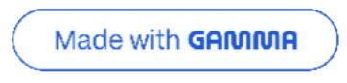
Customer Shopping Behavior Analysis
Uncovering actionable insights from 3,900 purchases to drive strategic growth

Slide 2

Analysis Foundation
DATASET OVERVIEW
3.9K
Total Purchases
Comprehensive transaction dataset
18
Data Points
Demographics, behavior, preferences
50
Locations
Nationwide coverage

Slide 3

Python-Powered Data Engineering
DATA PREPARATION
01 02
Data Loading & Exploration
Imported dataset with pandas, analyzed structure and statistics
Missing Data Handling
Imputed 37 missing review ratings using category median
03
Feature Engineering
Created age groups, purchase frequency metrics, standardized columns
04
Database Integration
Connected to PostgreSQL for advanced SQL analysis

Slide 4


SQL ANALYSIS
Key Business Insights
Structured queries revealed critical patterns across revenue, customer segments, and product performance

Slide 5
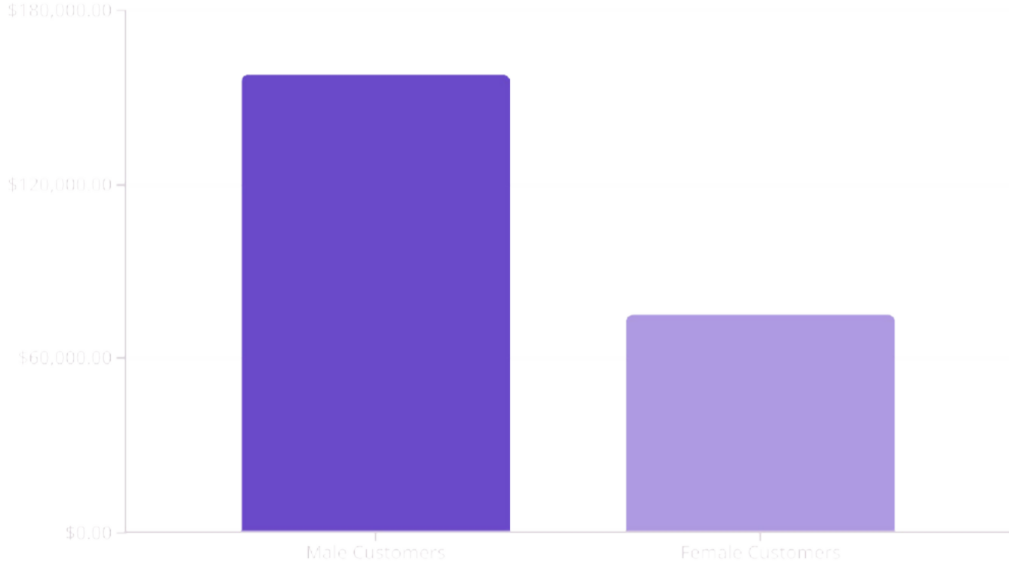
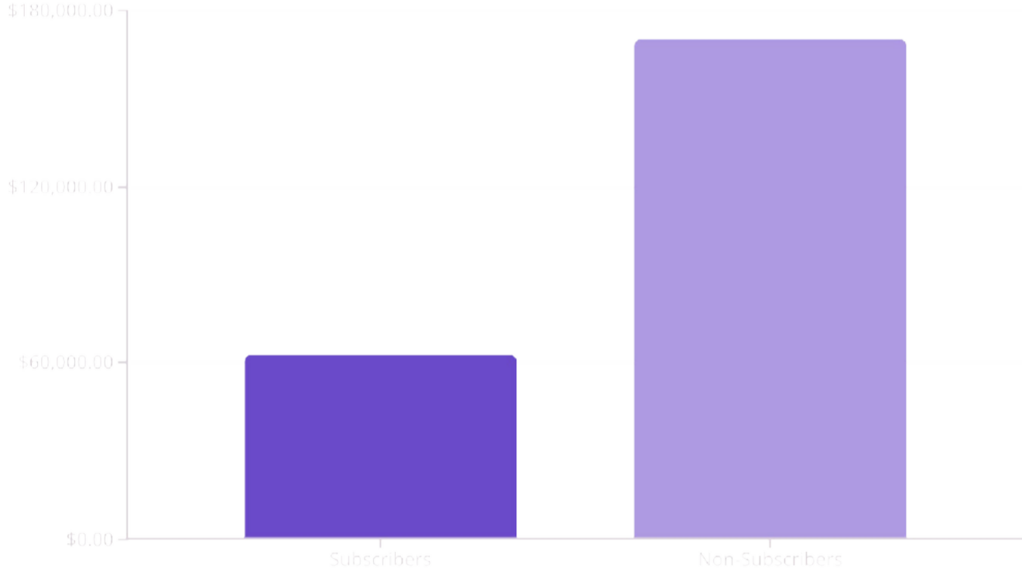
Revenue Distribution Analysis
Gender Revenue
Subscription Revenue
Gender Revenue Gap
Male customers generate 2.1x more revenue despite similar average spend ($59.87 vs $59.49)
Subscription Paradox
Non-subscribers drive 73% of total revenue but represent untapped retention opportunity

Slide 6




Top-Performing Products
Gloves
3.86 avg rating
Sandals
3.84 avg rating
Boots
3.82 avg rating
Hat
3.80 avg rating
Highest customer satisfaction
Strong seasonal performer
Consistent quality perception
50% discount dependency

Slide 7
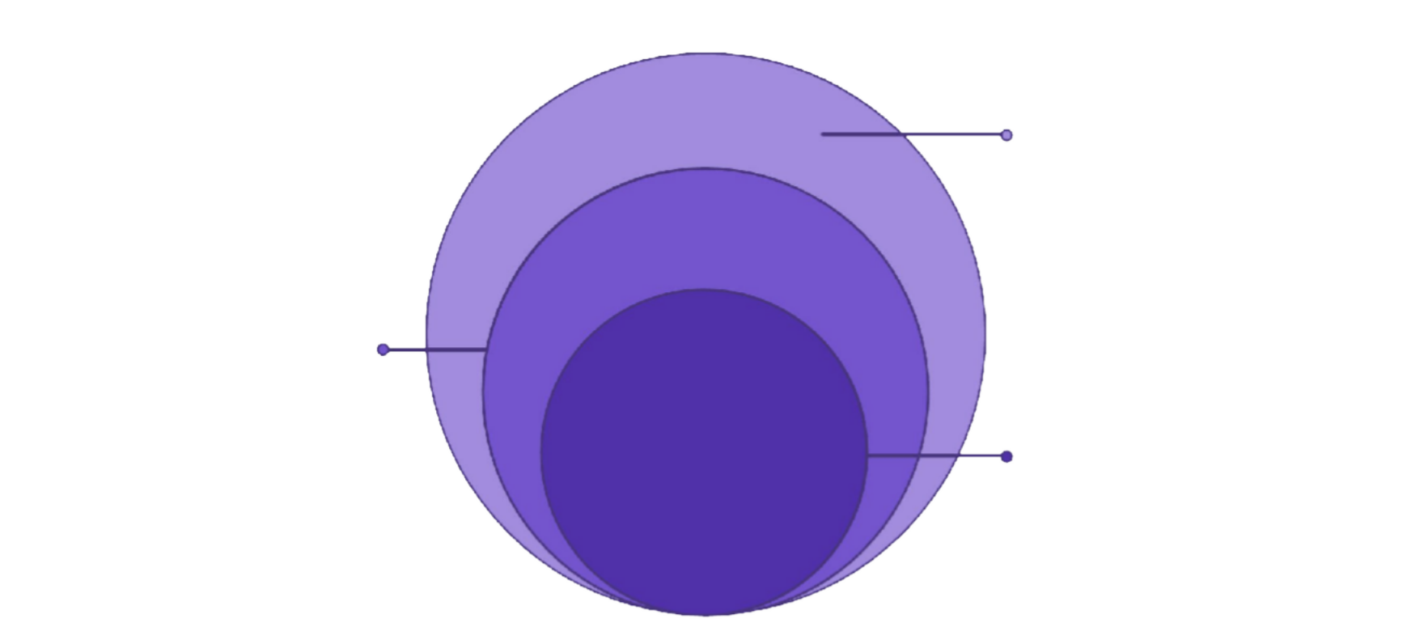
Loyalty Distribution
CUSTOMER SEGMENTS
New
83 customers — acquisition gap
Returning
701 customers — repeat
buyers
Loyal
3,116 customers — 80% retention
Strategic Opportunity
Only 83 new customers suggests acquisition channels need optimization
Returning segment (701) represents conversion opportunity to loyal status
80% of customers are classified as loyal, indicating strong retention but limited new acquisition

Slide 8
Shipping & Discount Behavior
Express Shipping Premium
$60.48 avg purchase vs $58.46 standard
Smart Discount Spenders
839 customers used discounts but spent above average
Discount-Dependent Items
Hats (50%), Sneakers (49.7%), Coats
(49.1%)
Higher-value customers prefer faster delivery
Discounts attract quality buyers, not just bargain hunters
These products rarely sell at full price

Slide 9




Interactive Dashboard Insights
POWER BI
27%
68%
45%
Subscription Rate
Significant growth potential
Male Customer Base
Driving majority revenue
Clothing Category
Share of total revenue

Slide 10

Strategic Recommendations
NEXT STEPS
Launch Subscription Incentive Program
Exclusive benefits to convert 73% non-subscriber base
Optimize Discount Strategy
Reevaluate pricing for discount- dependent products (hats, sneakers, coats)
Expand Express Shipping Options
Target premium customers willing to pay $2 more for faster delivery
Amplify Top-Rated Products
Feature gloves, sandals, boots in marketing campaigns
Strengthen Acquisition Funnel
Focus on converting 701 returning customers to loyal segment

